Slide 1
image caption generator
Team mates:
y. Praneetha
A. Keerthana
v. Naman
Tejavath rajesh
Mohammad adhil

Slide 2
Introduction:-
For a machine to be able to automatically describe objects in an image along with their relationships or the actions being performed using a learnt language model is a challenging task, but with massive impact in many areas. Being able to automatically describe the content of an image using properly formed English sentences is a challenging task, but it could have a great impact by helping visually impaired people better understand their surroundings
Most modern mobile phones are able to capture photographs, making it possible for the visually impaired to make images of their environments. These images can then be used to generate captions that can be read out loud to the visually impaired so that they can get a better sense of what is happening around them. We are creating a web application where the user selects the image and the image is fed into the model that is trained and generated caption will be displayed on the webpage.

Slide 3
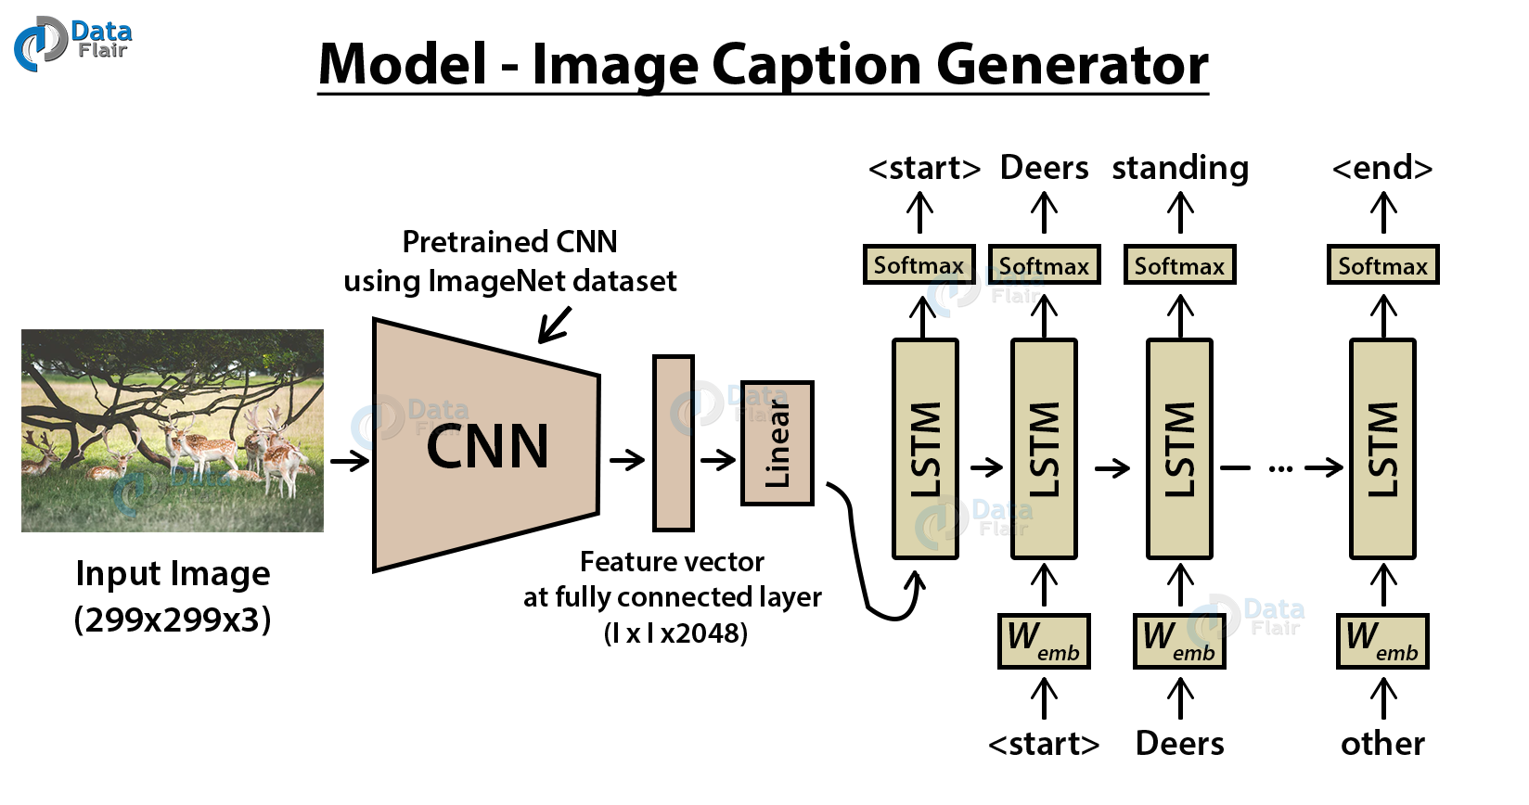
What is image caption generator ???
Image caption generator is a task that involves computer vision and natural language processing concepts to recognize the context of an image and describe them in a natural language like English.

Slide 4
Objective of the project
The objective of our project is to learn the concepts of a CNN and LSTM model and build a working model of Image caption generator by implementing CNN with LSTM.
In this Python project, we will be implementing the caption generator using CNN (Convolutional Neural Networks) and LSTM (Long short term memory). The image features will be extracted from Xception which is a CNN model trained on the imagenet dataset and then we feed the features into the LSTM model which will be responsible for generating the image captions.

Slide 5
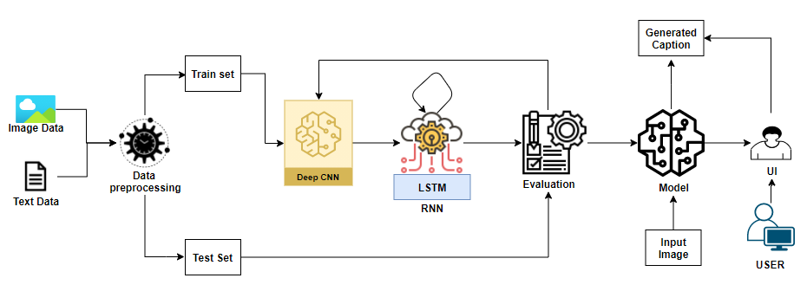
Model of image captioning
rchitecture:

Slide 6
The Problem statement
The problem introduces a captioning task, which requires a computer vision system to both localize and describe salient regions in images in natural language. The image captioning task generalizes object detection when the description consist of a single word.

Slide 7
What is CNN ?
Convolutional Neural networks are specialized deep neural networks which can process the data that has input shape like a 2D matrix. Images are easily represented as a 2D matrix and CNN is very useful in working with images.
What is LSTM ?
LSTM stands for Long short term memory, they are a type of RNN (recurrent neural network) which is well suited for sequence prediction problems. Based on the previous text, we can predict what the next word will be. It has proven itself effective from the traditional RNN by overcoming the limitations of RNN which had short term memory. LSTM can carry out relevant information throughout the processing of inputs and with a forget gate, it discards non-relevant information.
CNN is basically used for image classifications and identifying if an image is a bird, a plane or Superman, etc.

Slide 8
Problem solution
The proposed model has proven to be robust and able to accurately generate the captions for the images.
In this advanced Python project, we have implemented a CNN-RNN model by building an image caption generator.

Slide 9
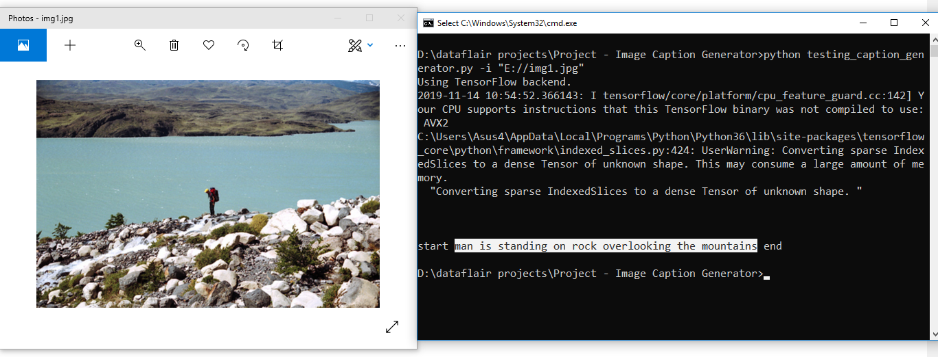
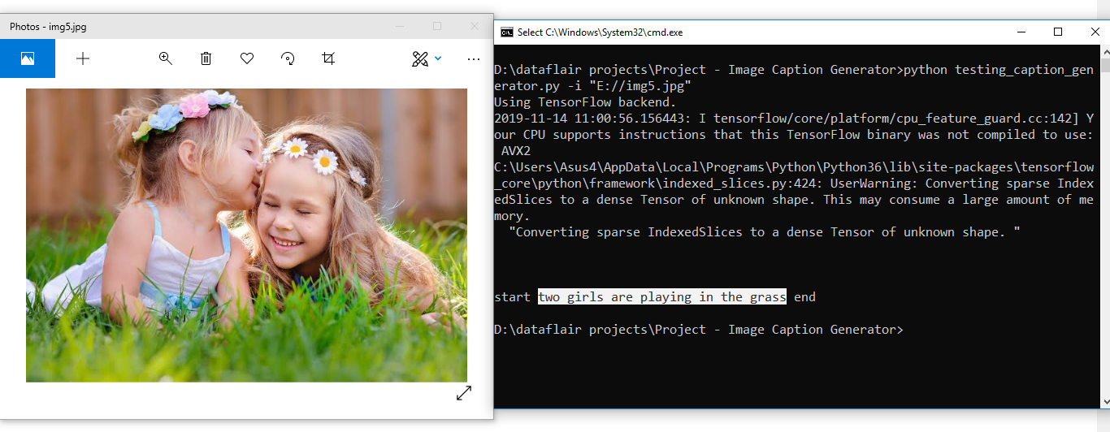
Outputs of the project

